Slide 1
Calculate BetweenNess centrality using brandes’ algorithm
Name - Snehal Gandham
Student Id - 79007757

Slide 2
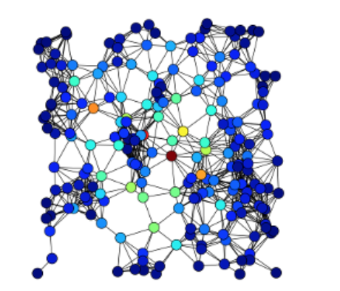
CENTRALITY
1_sgandham
In graph theory and network analysis, centrality highlights the most important vertices within a graph.

Slide 3
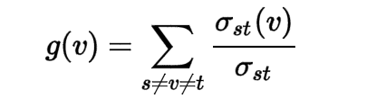
Betweenness centrality
The Betweenness Centrality for each vertex is the number of the shortest paths that pass through the vertex.
For example, in a telecommunication network, a node with higher Betweenness Centrality would have more control over the network, because more information will pass through that node.
The Betweeness Centrality is calculated by

Slide 4
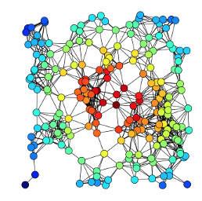
Applications
1_sgandham
Can be used to identify
The most influential person(s) in a social network.
Key infrastructure nodes in the internet or urban network.
Cell which can spread the disease.

Slide 5



Brandes’ algorithm
Calculating the betweenness and closeness centralities of all the vertices in a graph involves calculating the shortest paths between all pairs of vertices on a graph, which takes time with the Floyd–Warshall algorithm.
On a sparse graph, Brandes’ Algorithm will take
On unweighted graph, Brandes’ Algorithm will take

Slide 6
Progress…….
Understand Brandes’ Algorithm and implement.
Understand the calculation behind Betweenness Centrality.
UI has been built which can accept the input file.

